Slide 1
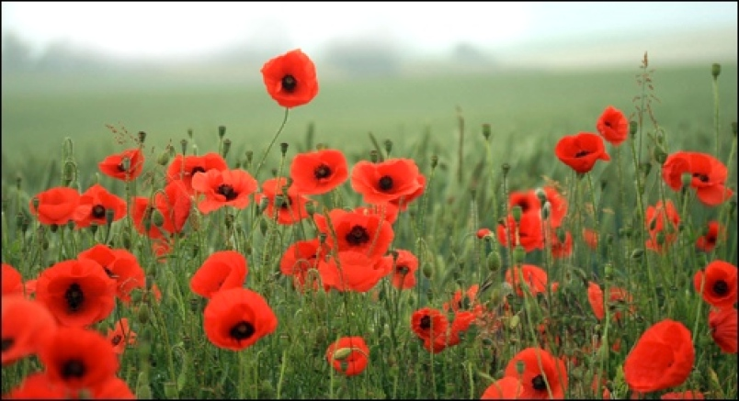
Why John McCrae should be on the new 5-dollar bill
By Noah Brule and Finley Whelan

Slide 2
Birthdate and day, he died
John McCrae was born on November 30, 1872 in Guelph, Ontario and died on January 28 ,1918 (aged 45)

Slide 3
John McCrae's Biography part 1
McCrae was born in McCrae House in Guelph, Ontario to Lieutenant-Colonel David McCrae and Janet Simpson Eckford; he was the grandson of Scottish immigrants from Balmaghie, Kirkcudbrightshire. His brother, Dr. Thomas McCrae, became professor of medicine at Johns Hopkins Medical School in Baltimore and close associate of Sir William Osler. His sister Geills married James F. Kilgour, a justice of the Court of King’s Bench, and moved to Winnipeg.

Slide 4
Biography part 2
McCrae attended the Guelph Collegiate Vocational Institute, but he took a year off his studies due to recurring problems with asthma.
Among his papers in the John McCrae House in Guelph is a letter he wrote on July 18, 1893, to Laura Kain's while he trained as an artilleryman at Tête-de-Pont barracks, today’s Fort Frontenac, in Kingston, Ontario. "I have a manservant ... Quite a nobby place it is, in fact ... My windows look right out across the bay and are just near the water's edge; there is a good deal of shipping at present in the port; and the river looks very pretty."
He was a resident master in English and Mathematics in 1894 at the Ontario Agricultural College in Guelph.

Slide 5
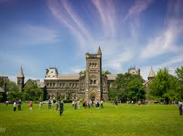
This is the school he went to
He went to University of Toronto, St George campus and Guelph Colligate Vocational Institute.

Slide 6
In Flanders Fields
John McCrae was a poet who was in the first World War. He was a doctor and helped injured soldiers and while he was in the field his friend got blown up and died so John wrote a poem for him.

Slide 7
The Effect of the Poem
In Flanders Fields, one of history’s most famous wartime poems, written in 1915 during the First World War by Canadian officer and surgeon John McCrae. It helped popularize the red poppy as a symbol of remembrance. It's still read around the world to this very day on Remembrance Day services even though it’s a Canadian poem. It was able to capture the essence of not only his friend's death but also the deaths of all the soldiers who fought in the war.

Slide 8
John McCrae's death
Weary and weakened, he was susceptible to pneumonia — a condition that killed many troops during the First World War. On 23 January 1918, he became ill. On 28 January, McCrae died of pneumonia and meningitis at the No. 14 British General Hospital in Wimereux, France.

Slide 9
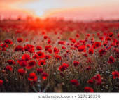
That’s why John McCrae should be on the 5-dollar bill

